Slide 1

Sistemi Wearable e Telemetria Medica
A.A 2024-25
(Final course project)
Wireless UHF RFID based bladder pressure sensor
TASK 1
Laboratorio
Elettromagnetismo
Pervasivo
Prof. G. Marrocco
Tutor: Ing. Francesca Nanni
1

Slide 2
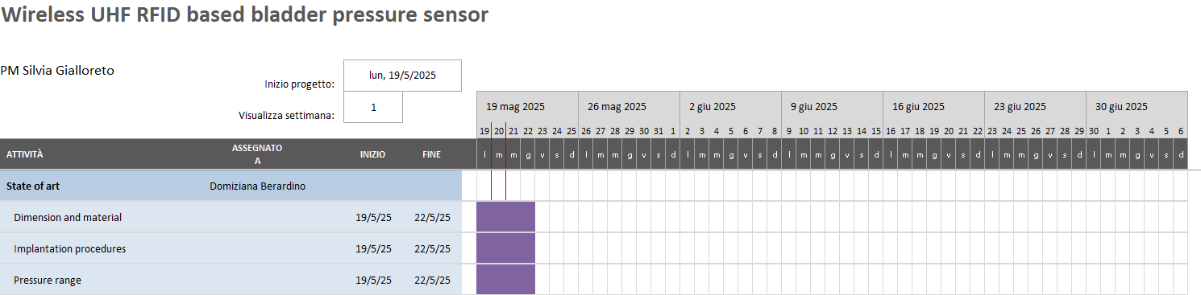

Slide 3
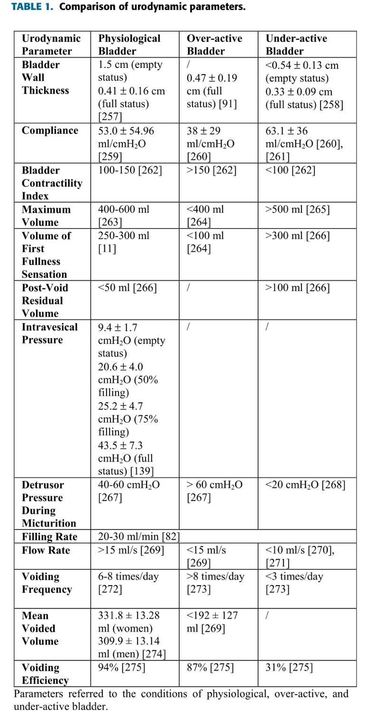
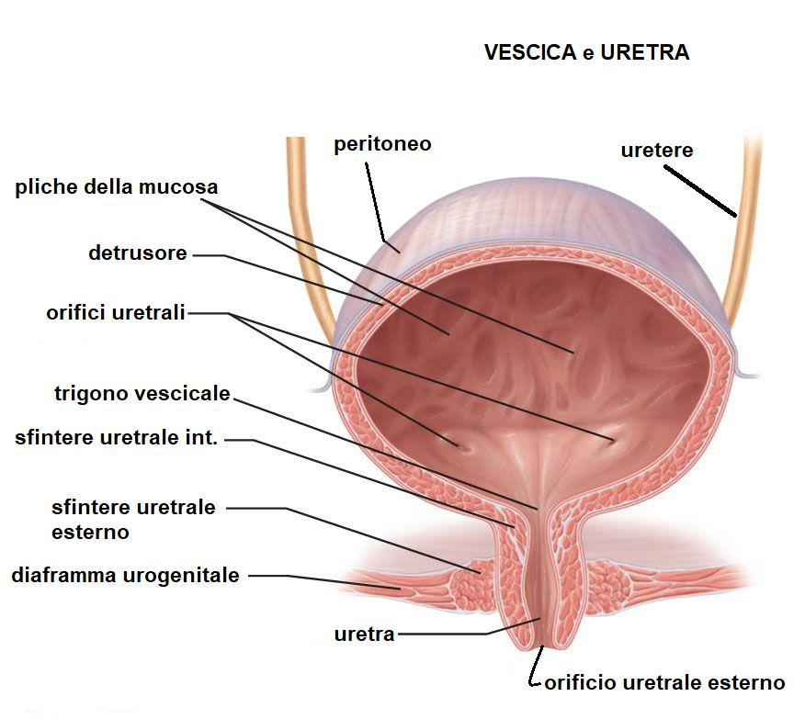
Introduction
The lower urinary tract (LUT) is susceptible to diseases, injuries, and dysfunctions of the nervous system that can lead to the loss or reduction of bladder fullness sensation. Special attention is given to two groups of monitoring devices: wearable devices for continuous and home monitoring and implantable sensors for chronic monitoring.
Dysfunctions of the urinary tract can be:
Non-neurogenic
Neurogenic
Degenerative and neurodegenerative

Slide 4
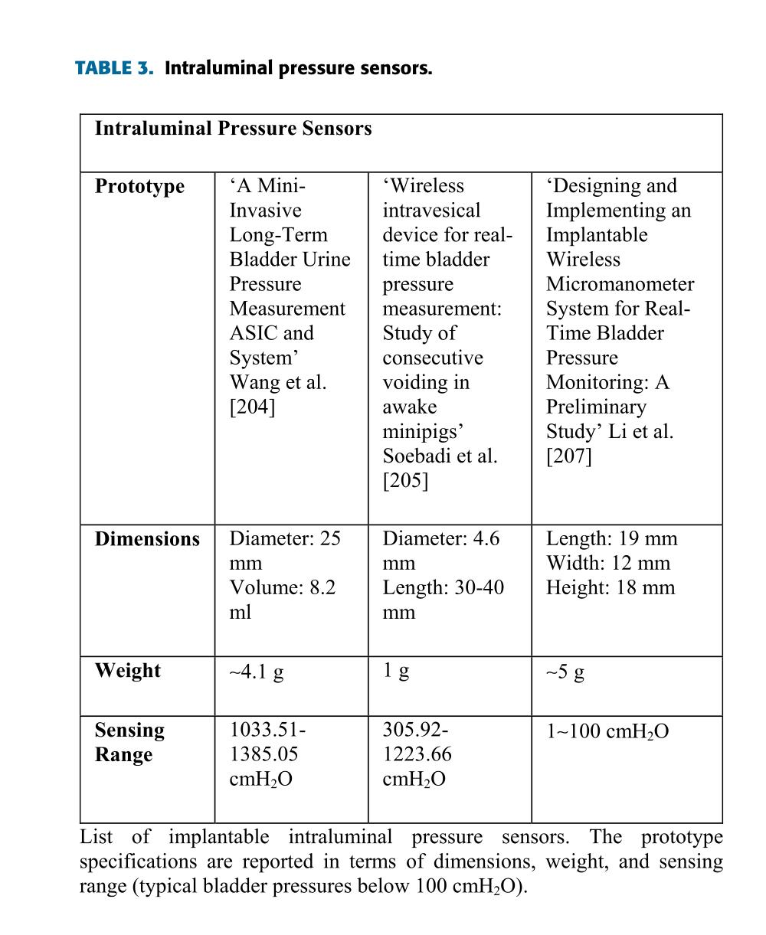
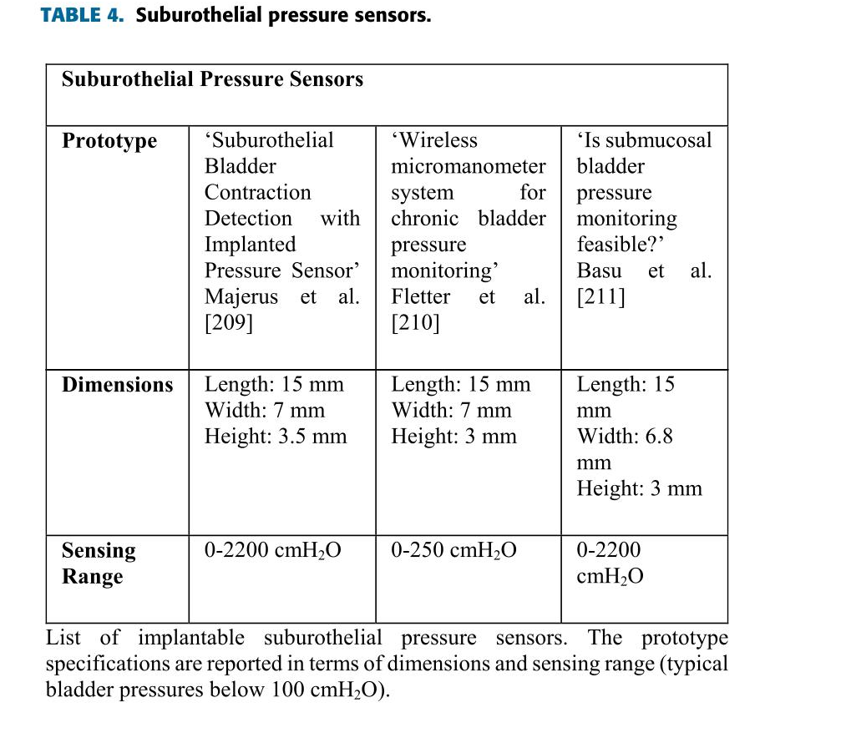
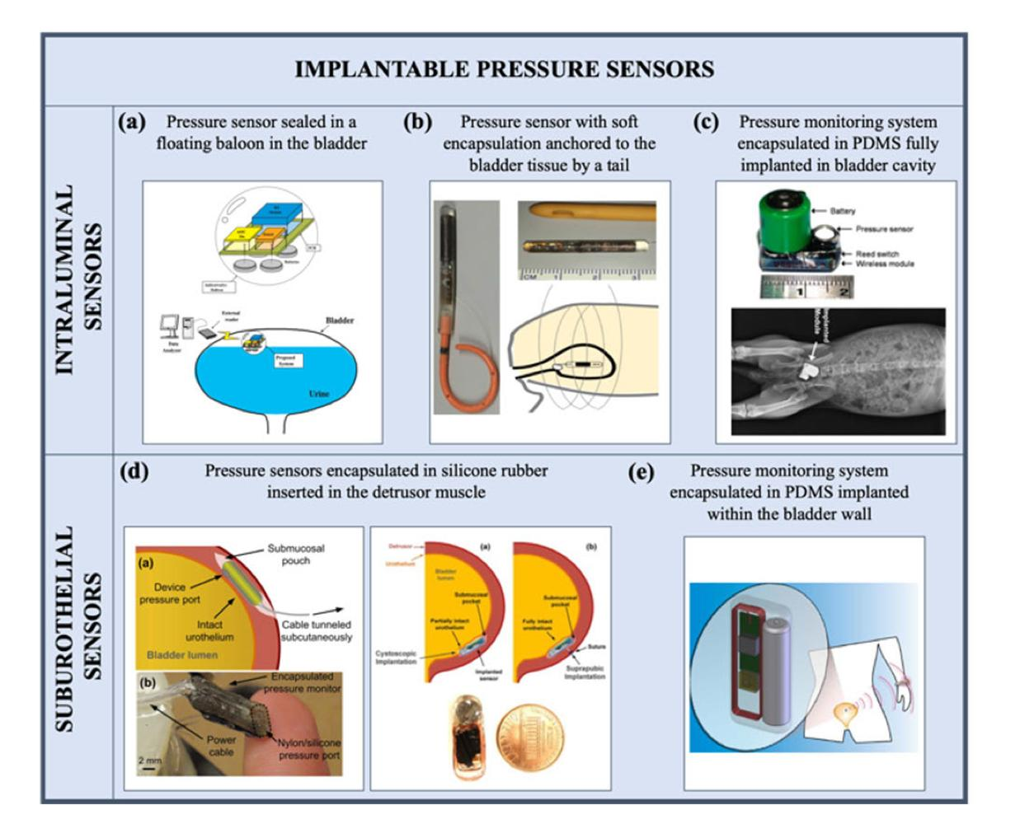
Implantable sensors
Among the anatomical and physiological parameters of the bladder, pressure and volume are the most studied.
Implantable pressure sensors:
Intraluminal sensors
Suburothelial sensors
Volume sensors:
Monitoring dimensional changes of the bladder
Monitoring the deformation of the bladder walls.

Slide 5
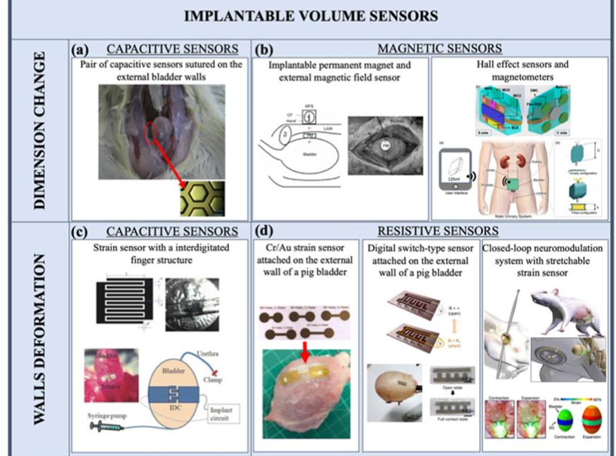
Implantable volume sensors:
The measurements of the dimensional variations of the bladder are based on the estimation of the distance between pairs of sensors anchored to the external bladder walls → capacitive and magnetic sensors.
The measurement of bladder deformations presents several challenges mainly related to the need to find an optimal mechanical compliance between the sensor and the tissue.

Slide 6
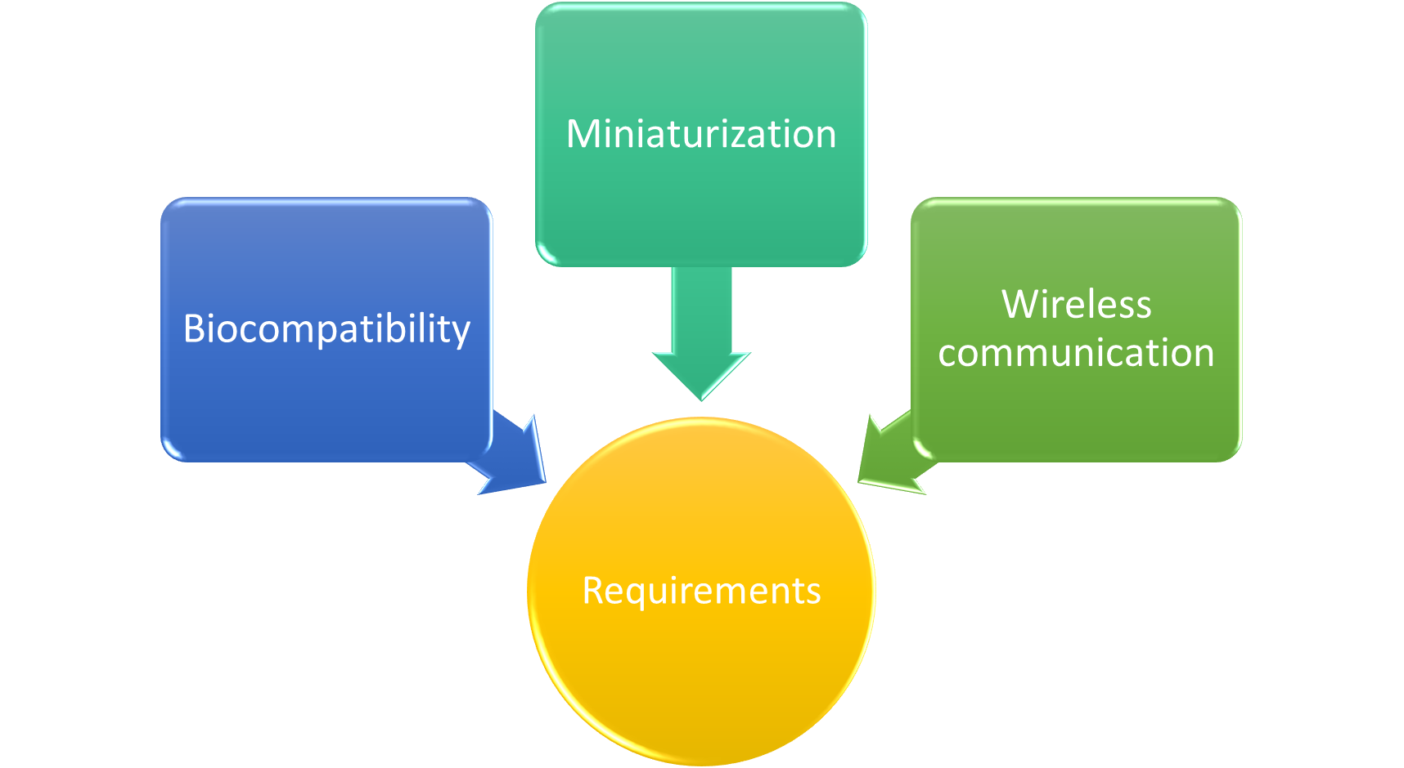
Conclusions

Slide 7

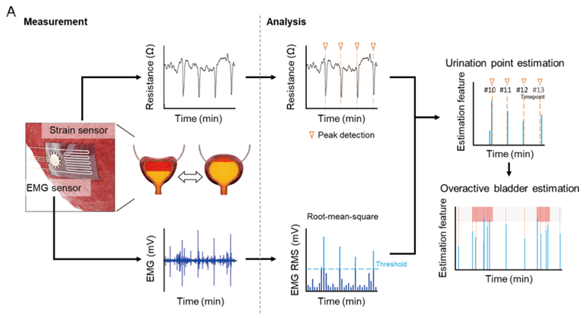
Clinical context: Overactive Bladder (OAB) affects over 20% of individuals over 40 and can cause psychological distress, kidney damage, and social isolation.
Objective: Develop an implantable, adhesive, and ultra-soft sensor for simultaneous monitoring of contraction (strain) and EMG of the bladder wall.

Slide 8
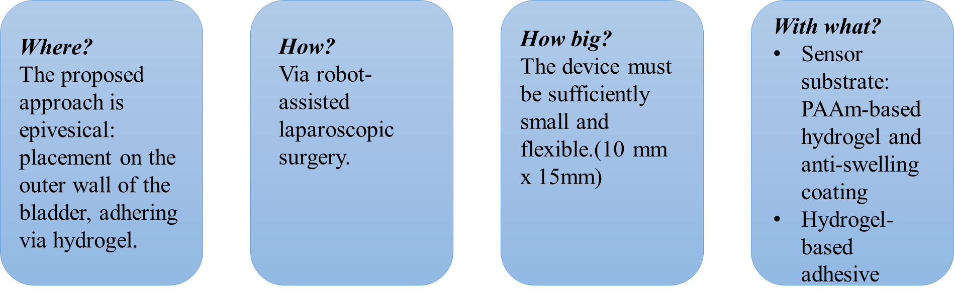
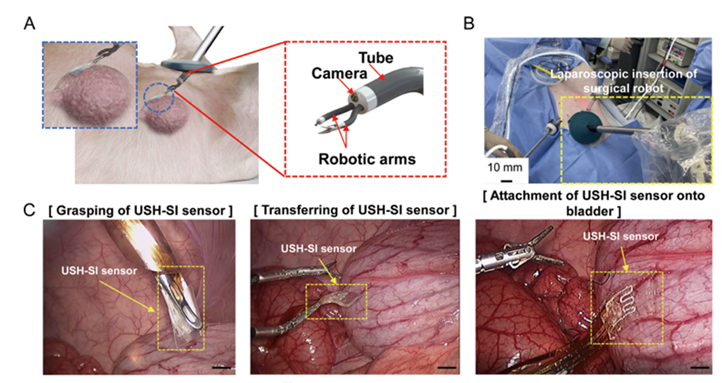
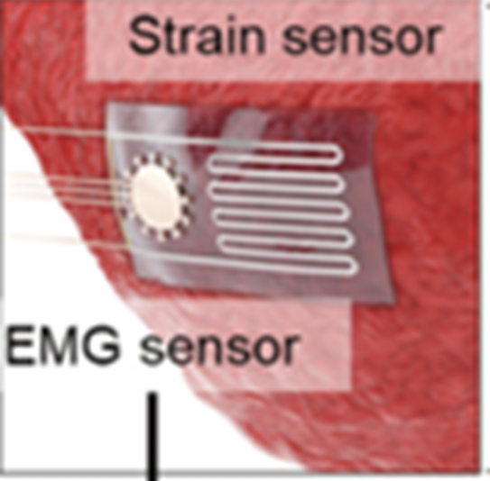
Anatomical Implantation Sites

Slide 9
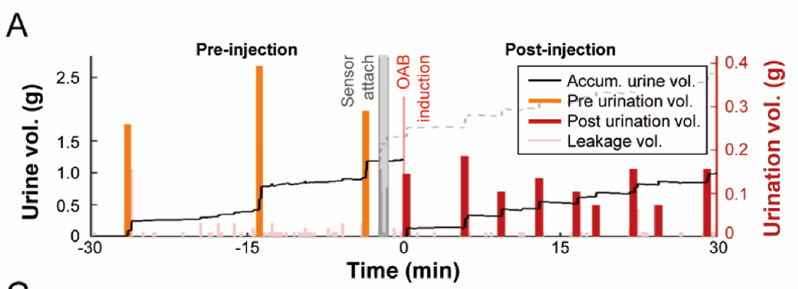
Bladder Pressure Analysis
Pathological conditions:
Detrusor overactivity
Vesicoureteral reflux
Bladder outlet obstruction
Physiological conditions:
Filling -> 10-20 cmH₂O,
Voiding -> 80-100 cmH₂O

Slide 10

Next step and project potential
Innovative and biocompatible design
Stable adhesion
Minimally invasive
Wireless potential

Slide 11
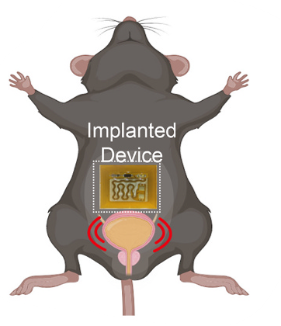
Device for Electrical Neuromodulation of Bladder Contractions
Wireless, implantable, battery-free device
Stimulates the major pelvic ganglion to control bladder muscle contractions
Alternative to conventional devices for treating urinary dysfunctions

Slide 12
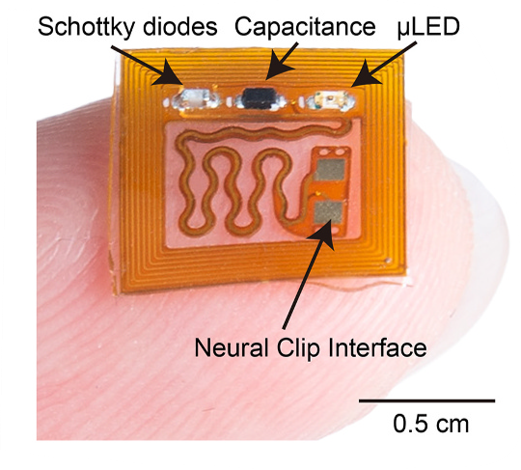
Constraints and Biomedical Design
Location
Subcutaneous implantation in the abdomen near the MPG
Fixed in place using sutures and biocompatible adhesives
Size and Weight
1x1x0,1 cm
<0,2 gr
Material
Encapsulation with a double layer of PDMS (20–200 μm)

Slide 13
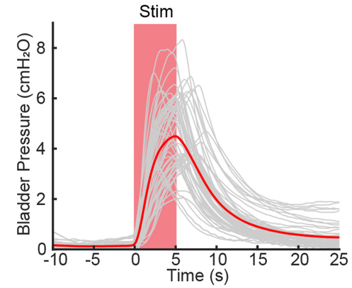
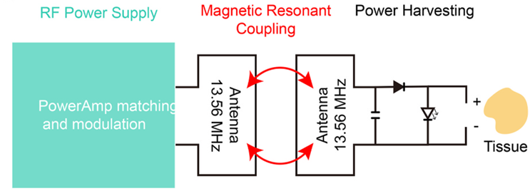
Power Transmission and Results
Stable Magnetic Coupling (Fixed Posture)
Results
External RF transmission antenna: single-loop, powered by a 13.56 MHz signal generator
Internal receiving antenna: dual-loop, created by laser ablation on a flexible printed circuit
IVP increased up to 6 cmH₂O in response to stimulation
Induced urination: ΔP ≈ 2 cmH₂O

Slide 14




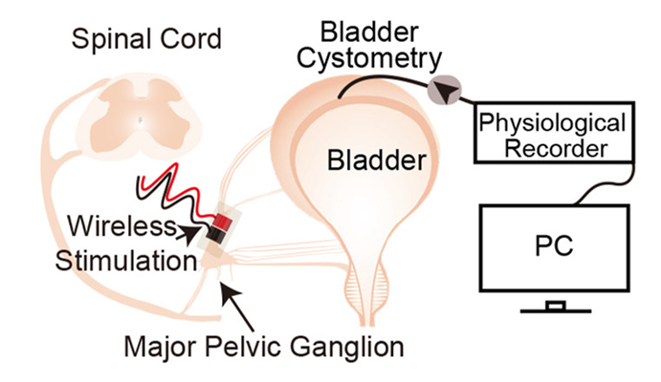


Conclusions and Future Perspectives
Minimally Invasive
Dynamic Adjustment of Stimulation Parameters
No Increase in Tissue Temperature
Low-cost
Future research must still ensure long-term efficacy

Slide 15
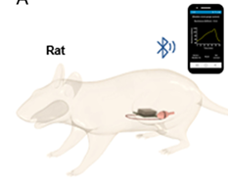
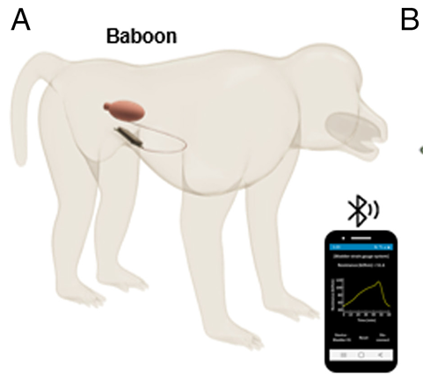
A wireless system for monitoring urinary bladder function following surgical recovery
Fully implantable and wireless system
Monitoring postoperative bladder recovery
Strain gauge and base station
Measurement of bladder deformation

Slide 16
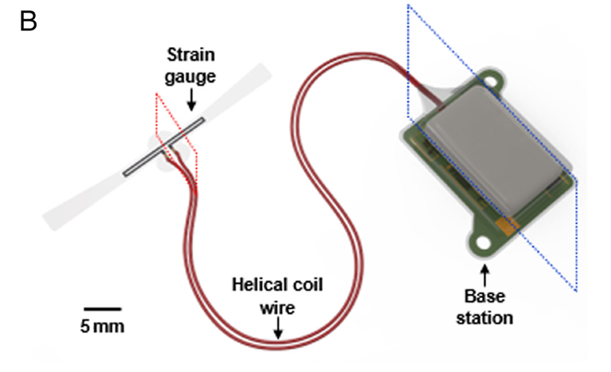
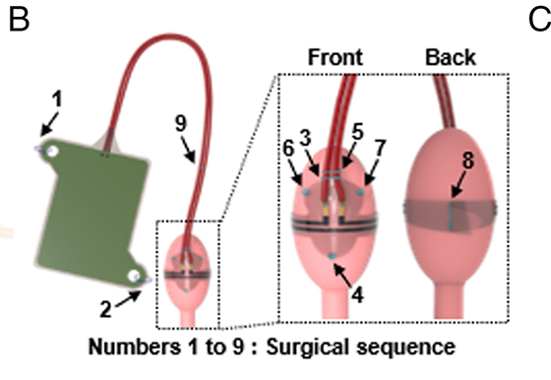
Device structure and implantation procedure
Device:
Strain gauge: soft, stretchable, wraps around the bladder (3mm)
Base station: subcutaneous module with BLE and battery (22,5x0,6x13mm)
Connected by helical wires
Implantation:
Strain gauge: sutured to bladder wall
Base station: sutured inside abdominal wall
Helical wires: sutured to bladder at 2 points for mechanical stability

Slide 17
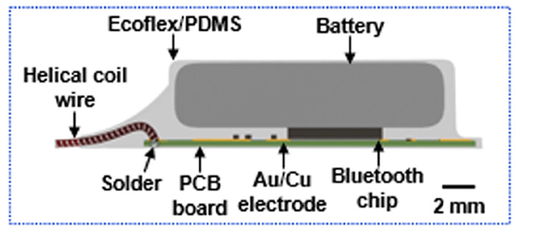
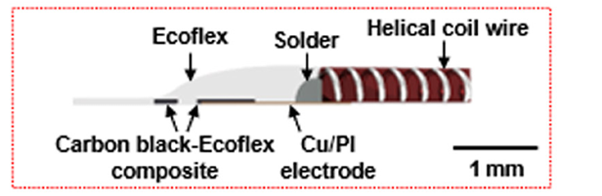
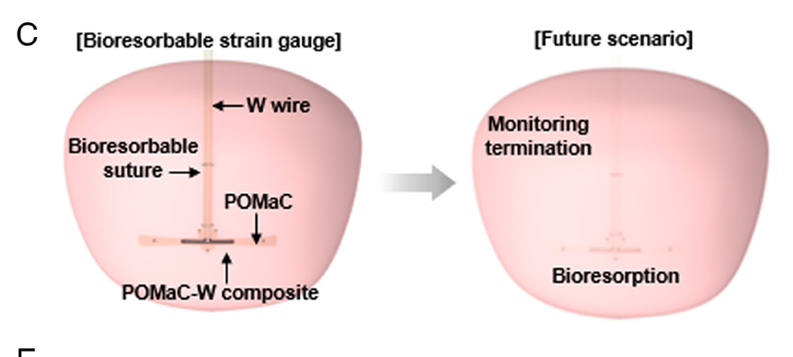
Materials
Base station:
PCB, BLE module, battery
Encapsulation: parylene, marine epoxy, PDMS
Strain gauge (permanent):
Substrate: Ecoflex 00-30
Conductive layer: carbon black–doped silicone
Electrodes: copper/polyimide (Cu/PI)
Encapsulation: silicone
Strain gauge (bioresorbable):
Polymer: POMaC and Tungsten
Electrodes: tungsten wires

Slide 18
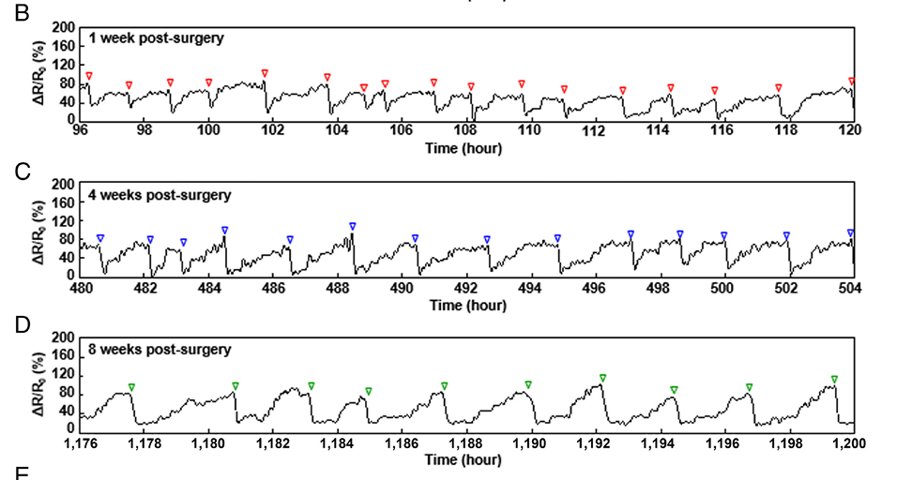
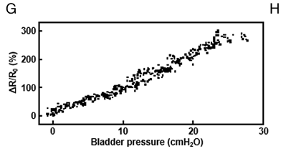
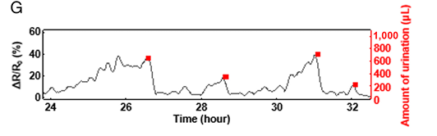
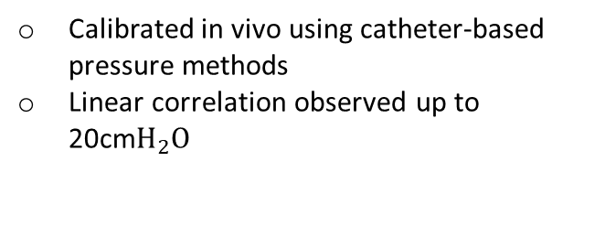
Tests and Bladder Pressure Estimation
Tests in rodent model:
Tests in primate model:
Bladder pressure estimation
Strain signal increases during filling and drops during voiding
Validated detection of small voiding volumes
Long term monitoring (8weeks)
Detected stabilization of micturition frequency after 6 weeks
Calibrated in vivo using catheter-based pressure methods
Linear correlation observed up to 20cm$H_{2}O$

Slide 19

Conclusions
Pros:
Cons:
Implantation techniques and position do not constrainbladder function
No long-term infetion or inflammatory response observed in rats or primates
Explored a bioresorbable sensor design
No solution for energy management
Pressure calibration limited to 20 cm$H_{2}O$
Pressure calibration limited to 20 cmH_2 O
No human trials
Pressure estimation depends on tissue mechanics

Slide 20
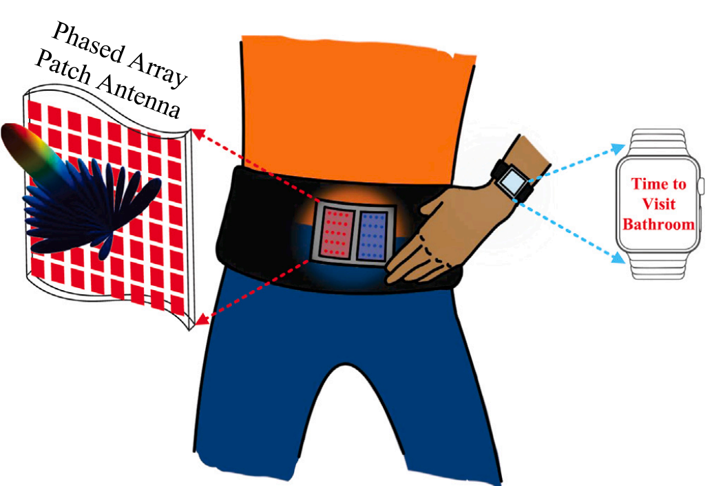
Bladder Volume Sensing via FMCW radar
Why?
No need for device implantation
Critical for cases where patients have no control of the bladder voiding
Pressure sensing could be not enough

Slide 21
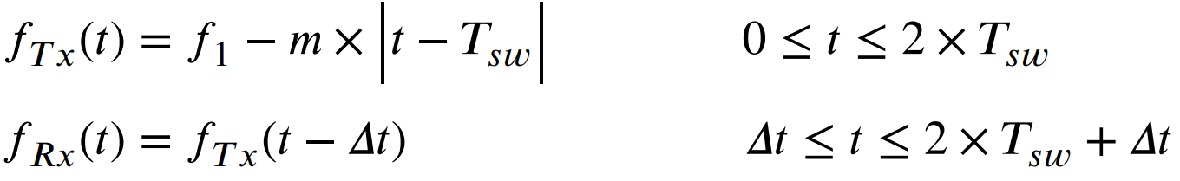
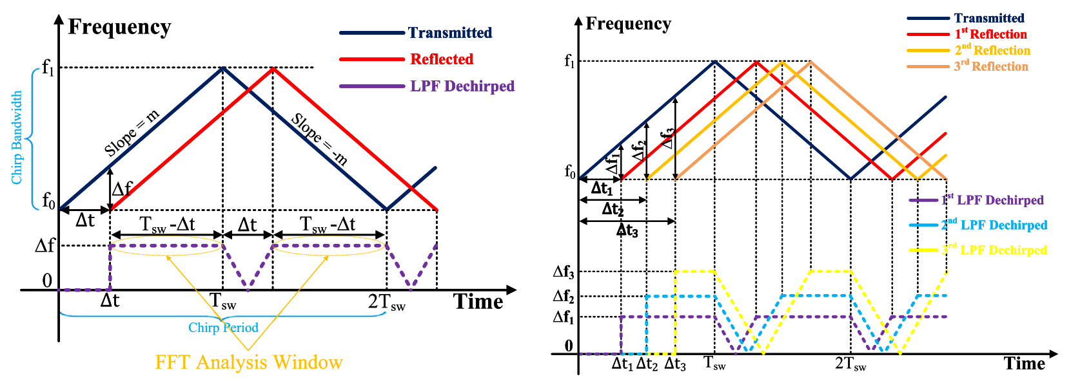
FMCW Radar Working Principle
Chirped transmitted signal with linear relationship of frequency
Delayed reflected signal
Mixing of Tx and Rx signals to detect "beat frequency" (LPF Dechirped)
​
Measure of beat frequency difference between two consecutive sweep of the Tx signal to detect a movement of the target

Slide 22
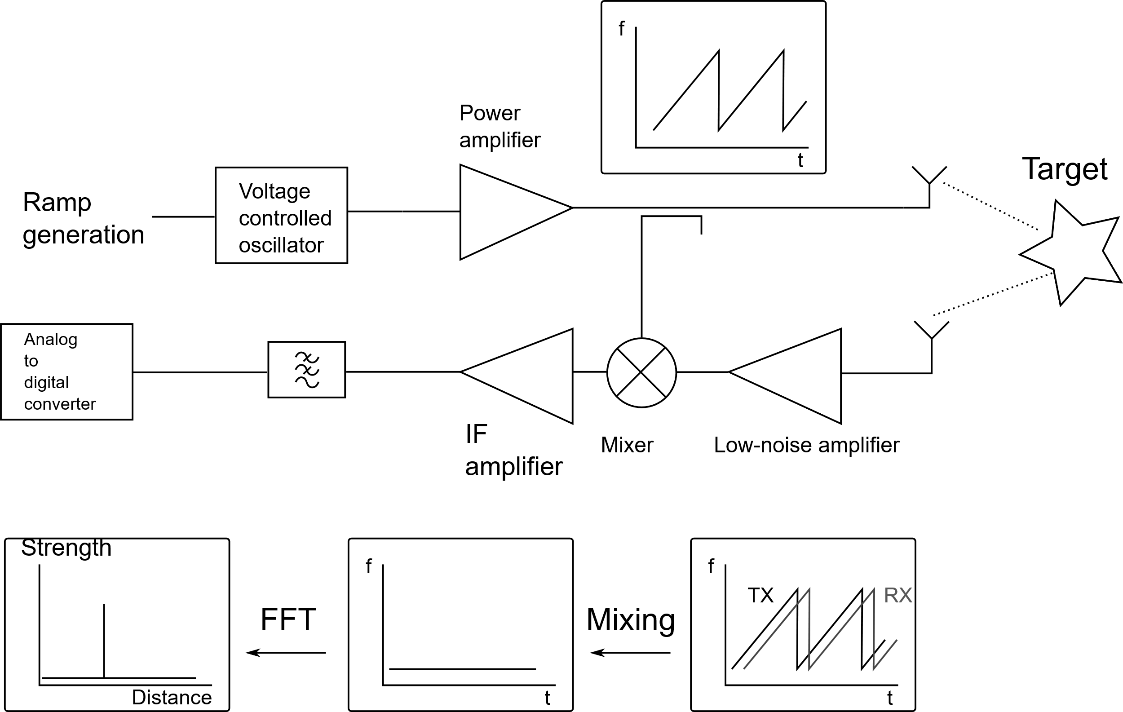

Slide 23
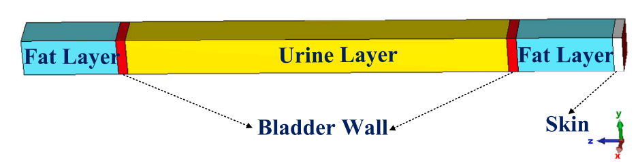
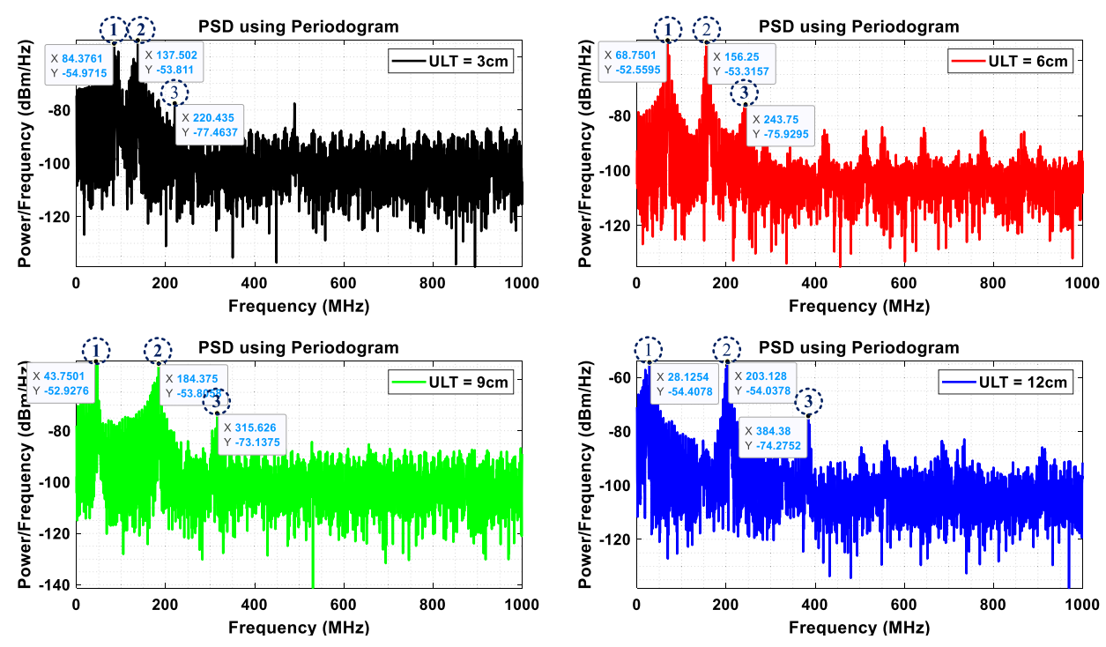
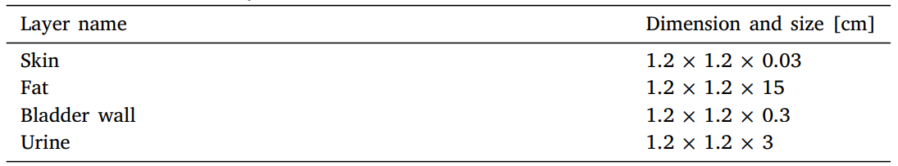
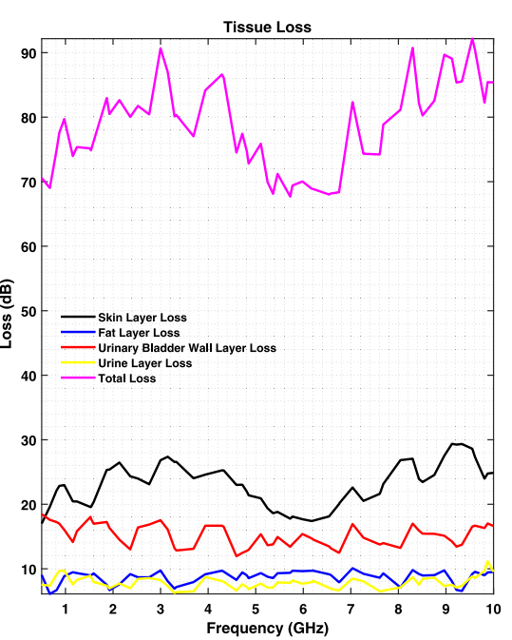
CST Simulation
CST Model
​
Results
Loss calculations

Slide 24
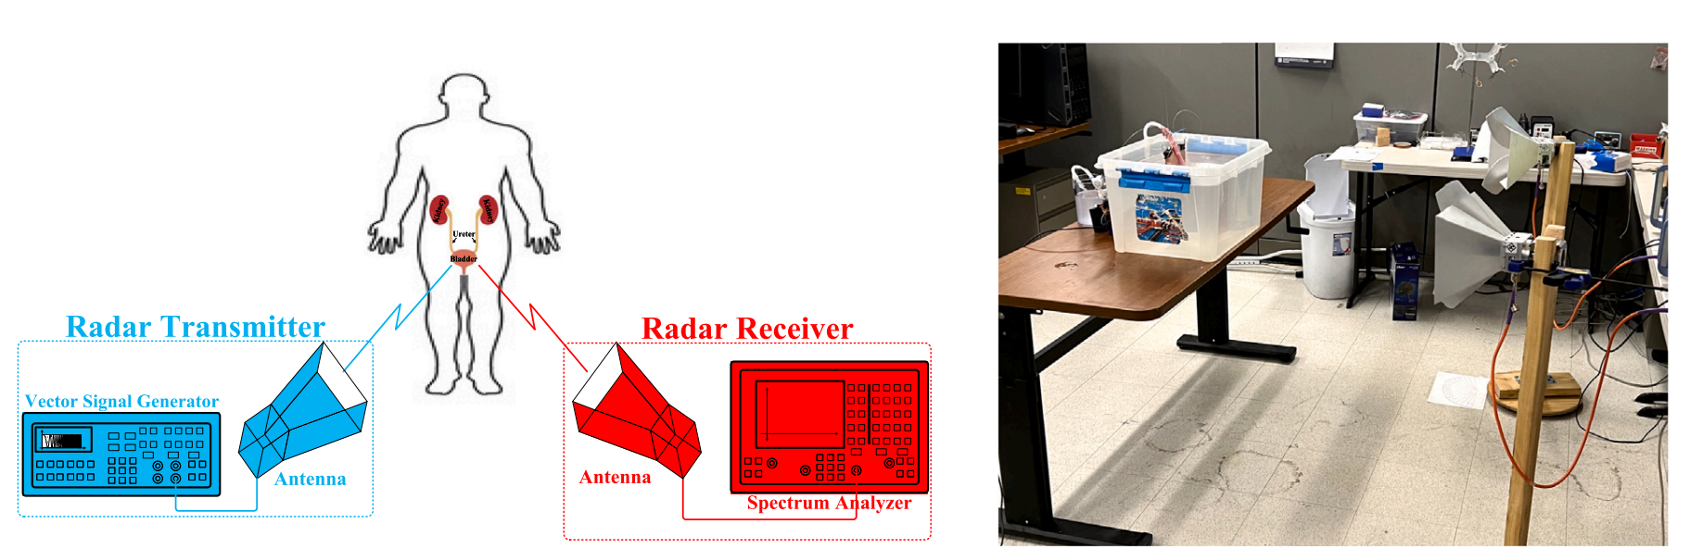
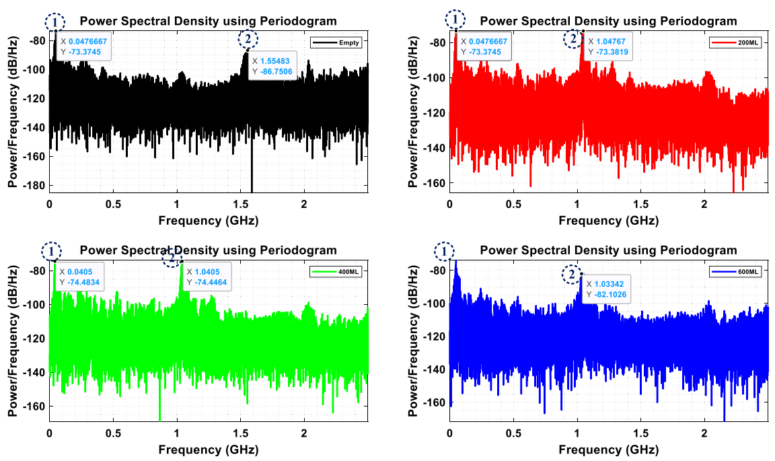
Ex-Vivo Bladder Model Simulation
Pig Bladder filled with saline solution
Variation of bladder volume to detect different beat frequency
​
Problems
Impact of motion and patient posture
Effect of prolonged exposure to High-Frequency FMCW
Dimension
Cost

